Slide 1

Data Structure and algorithms
Assistant.Prof.Dr/ Mohamed Sayed Kayed
Eng. Ahmed Mahmoud Sultan

Slide 2







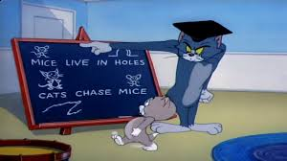
Phone
Instructor
Questions
Rules
Bonus
Attendance
Assignment
Eat & Drink
expulsion

Slide 3
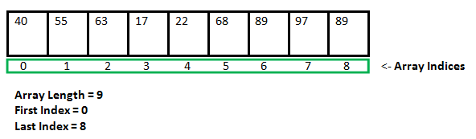
Arrays 1D and 2D

Slide 4
Creating, Initializing, and Accessing an Array One-Dimensional Arrays :
byte byteArray[];
short shortsArray[];
boolean booleanArray[];
long longArray[];
float floatArray[];
double doubleArray[];
char charArray[];
// an array of references to objects of
// the class MyClass (a class created by
// user)
MyClass myClassArray[];
Object[] ao, // array of Object
Collection[] ca; // array of Collection
// of unknown type
type var-name[];
OR
type[] var-name;
// both are valid declarations
int intArray[];
or
int[] intArray;

Slide 5
Instantiating an Array in Java
When an array is declared, only a reference of array is created. To actually create or give memory to array, you create an array like this:The general form of new as it applies to one-dimensional arrays appears as follows:
var-name = new type [size];
Example:
int intArray[]; //declaring array
intArray = new int[20]; // allocating memory to array
OR
int[] intArray = new int[20]; // combining both statements in one

Slide 6
Accessing Java Array Elements using for Loop
class GFG
{
public static void main(String[] args)
{
// declares an Array of integers.
int[] arr;
// allocating memory for 5 integers.
arr = new int[5];
// initialize the first elements of the array
arr[0] = 10;
arr[1] = 20;
arr[2] = 30;
arr[3] = 40;
arr[4] = 50;
// accessing the elements of the specified array
for (int i = 0; i < arr.length; i++)
System.out.println("Element at index " + i +" : " +arr[i]);
}
}

Slide 7
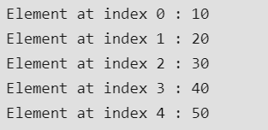
Output of last program

Slide 8
Arrays of Objects
Student[] arr = new Student[7]; //student is a user-defined class
// Java program to illustrate creating an array of
// objects
class Student
{
public int roll_no;
public String name;
Student(int roll_no, String name)
{
this.roll_no = roll_no;
this.name = name;
}
}

Slide 9
public class GFG
{
public static void main(String[] args)
{
// declares an Array of integers.
Student[] arr;
// allocating memory for 5 objects of type Student.
arr = new Student[5];
// initialize the first elements of the array
arr[0] = new Student(1, "aman");
arr[1] = new Student(2, "vaibhav");
arr[2] = new Student(3, "shikar");
arr[3] = new Student(4, "dharmesh");
arr[4] = new Student(5, "mohit");
// accessing the elements of the specified array
for (int i = 0; i < arr.length; i++)
System.out.println("Element at " + i + " : " + arr[i].roll_no + " " + arr[i].name);
}
}

Slide 10
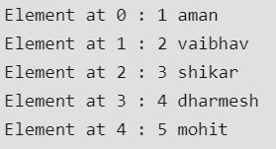
Output of last Program

Slide 11
Multidimensional Arrays
Multidimensional arrays are arrays of arrays with each element of the array holding the reference of other array.
Example:
int[][] intArray = new int[10][20]; //a 2D array or matrix
int[][][] intArray = new int[10][20][10]; //a 3D array

Slide 12
2D-Arrays
class multiDimensional
{
public static void main(String args[])
{
// declaring and initializing 2D array
int arr[][] = { { 2, 7, 9 }, { 3, 6, 1 }, { 7, 4, 2 } };
// printing 2D array
for (int i = 0; i< 3; i++)
{
for (int j = 0; j < 3; j++)
System.out.print(arr[i][j] + " ");
System.out.println();
}
}
}

Slide 13
Program to find the frequency of each element in the array
In this program, we have an array of elements to count the occurrence of its each element. One of the approaches to resolve this problem is to maintain one array to store the counts of each element of the array. Loop through the array and count the occurrence of each element as frequency and store it in another array fr.
Example:
1 2 8 3 2 2 2 5 1

Slide 14
public class Frequency {
public static void main(String[] args) {
//Initialize array
int[] arr = new int [] {1, 2, 8, 3, 2, 2, 2, 5, 1};
//Array fr will store frequencies of element
int[] fr = new int[arr.length];
int visited = -1;
for (int i = 0; i < arr.length; i++)
{
int count = 1;
for (int j = i + 1; j < arr.length; j++)
{
if (arr[i] == arr[j])
{
count++;
//To avoid counting same element again
fr[j] = visited;
}
}
if (fr[i] != visited)
fr[i] = count;
}

Slide 15
//Displays the frequency of each element present in array
System.out.println("---------------------------------------");
System.out.println(" Element | Frequency");
System.out.println("---------------------------------------");
for (int i = 0; i < fr.length; i++){
if (fr[i] != visited)
System.out.println(" " + arr[i] + " | " + fr[i]);
}
System.out.println("----------------------------------------");
}
}

Slide 16
Task1
Program to print the largest element in an array
Example:-

Slide 17
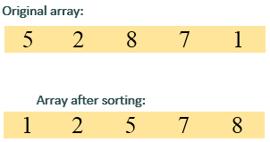
Java Program to sort the elements of an array in ascending order
In this program, we need to sort the given array in ascending order such that elements will be arranged from smallest to largest. This can be achieved through two loops. The outer loop will select an element, and inner loop allows us to compare selected element with rest of the elements.

